Slide 1
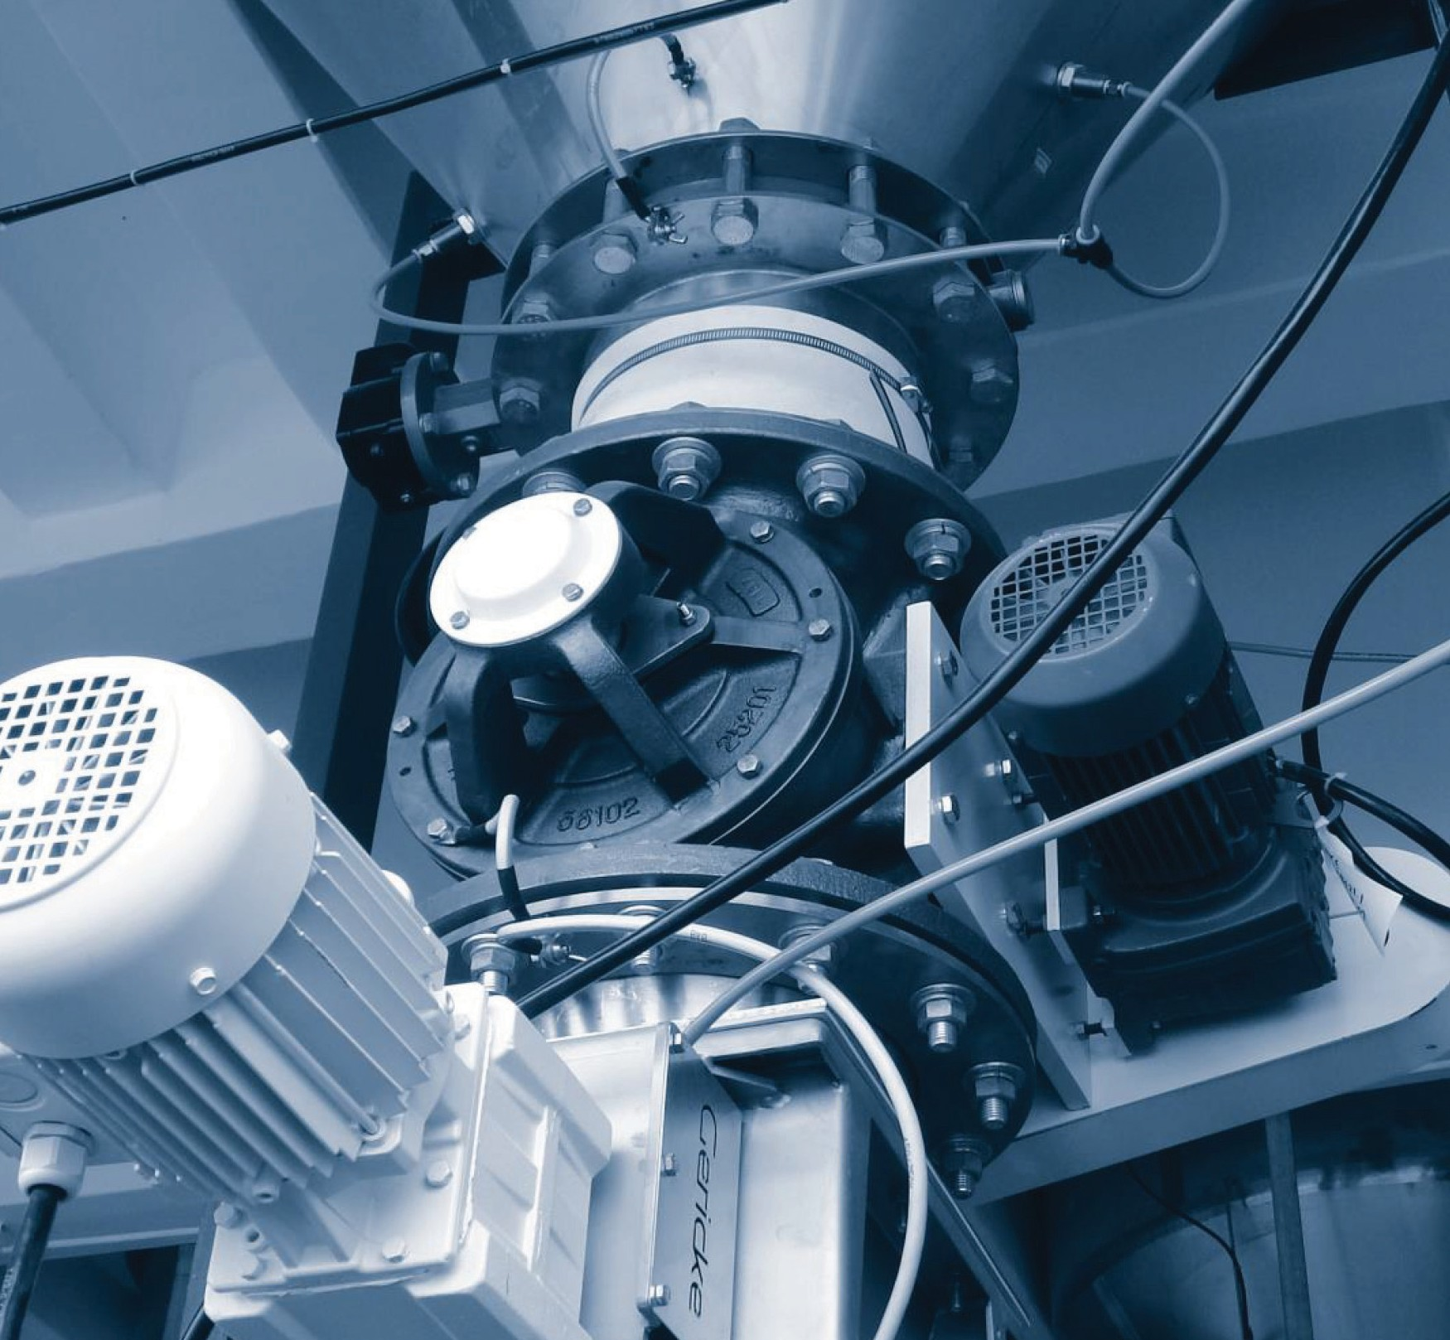
ROTARY VALVES: AN INTRODUCTION TO SELECTION AND USE
BY SHANGHAI YOUWEI’S POWDER EQUIPMENTS LTD
yOUWEI

Slide 2
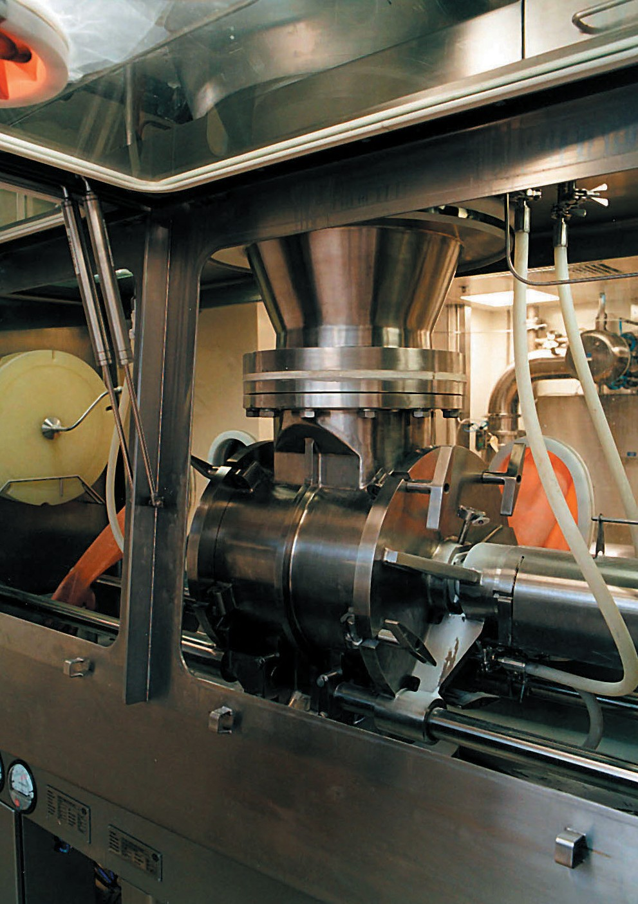
www.uv-powder.com
06

Slide 3
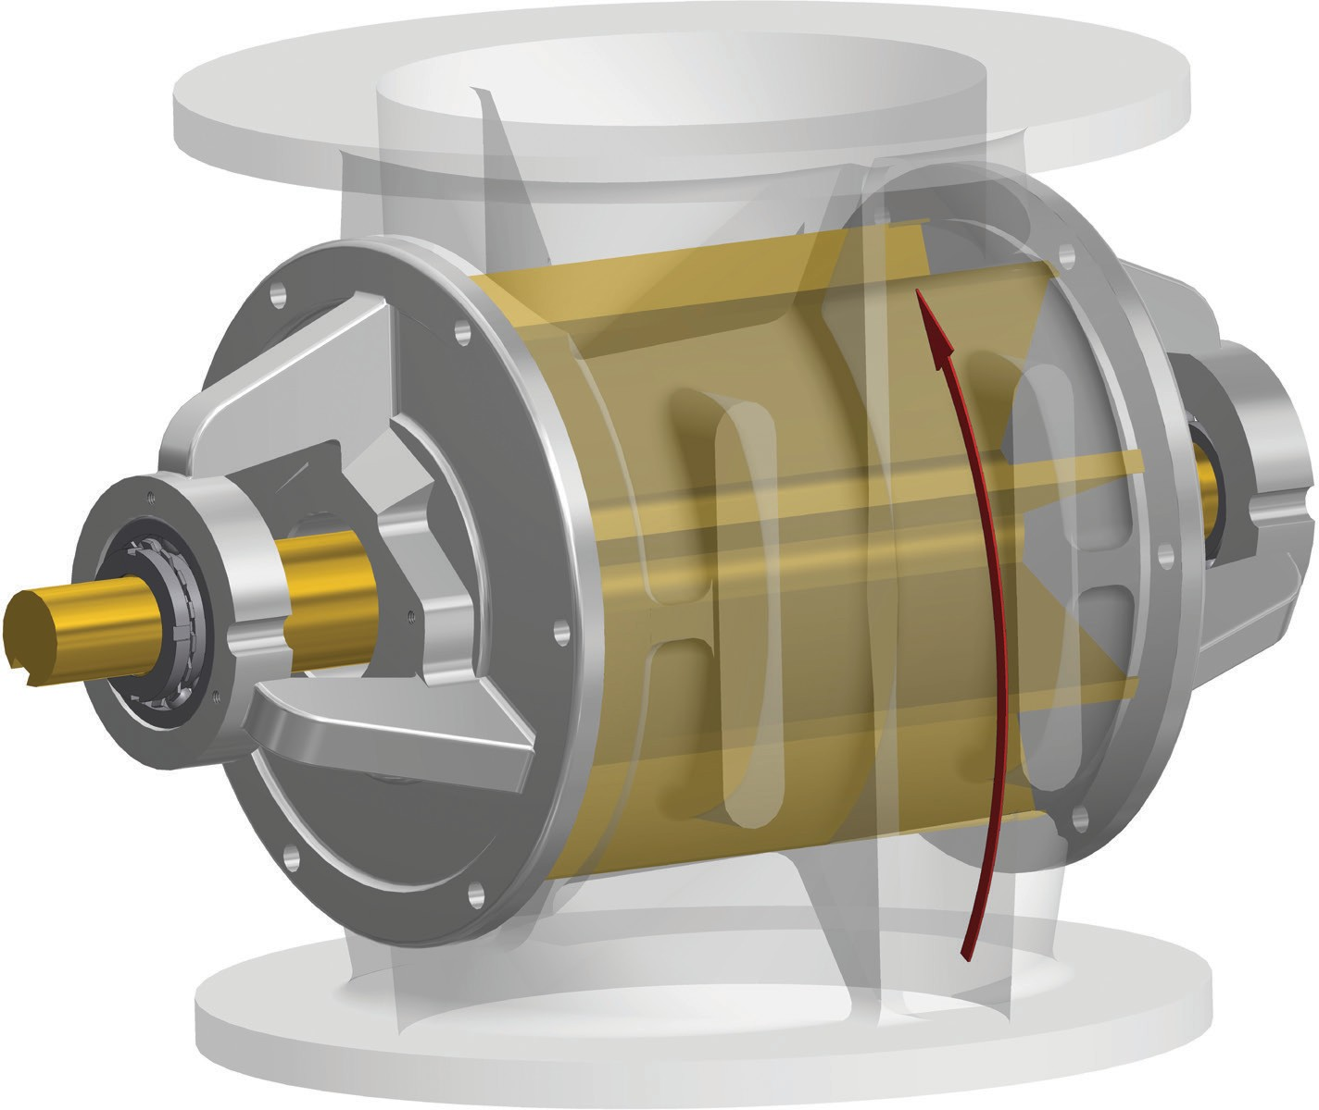
1. INTRODUCTION
Rotary Valves are compact devices widely used in bulk handling systems to control the discharge of powders and granular solids, normally under gravity, between two parts of a system; usually when there is a gas pressure differential between the two parts.
Whereas the compact and economic simplicity
of rotary valves provided for continuous development over time to become highly versatile devices, and
are now established as important, reliable, and often vital components when correctly specified for the application.
By definition, in their basic construction - ignoring any drive, they are the simplest of machines each incorporating just one moving element; a multi-vane rotor.
Yet until relatively recently rotary valves were often much maligned, due to customers often experiencing unreliable performance. As a result, many engineers actively sought alternative solutions or devices but with very limited success and only then in clearly defined applications.
That it can be a complex subject is reflected in the fact that SHANGHAI YOUWEI’ has a standard range of rotary valves supplemented by many thousands of standard options; as well as developing bespoke features
or units when required.
ONE MOVING ELEMENT!
MANY THOUSANDS OF OPTIONS!
07

Slide 4
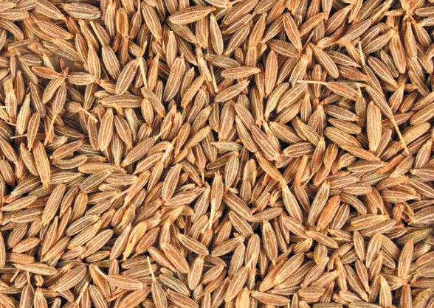
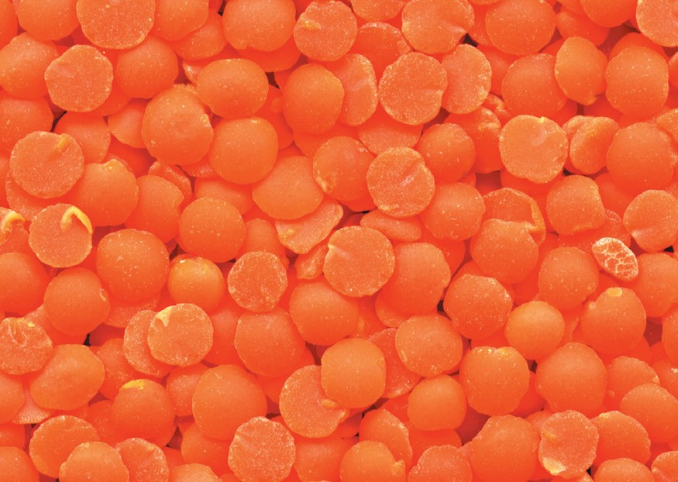
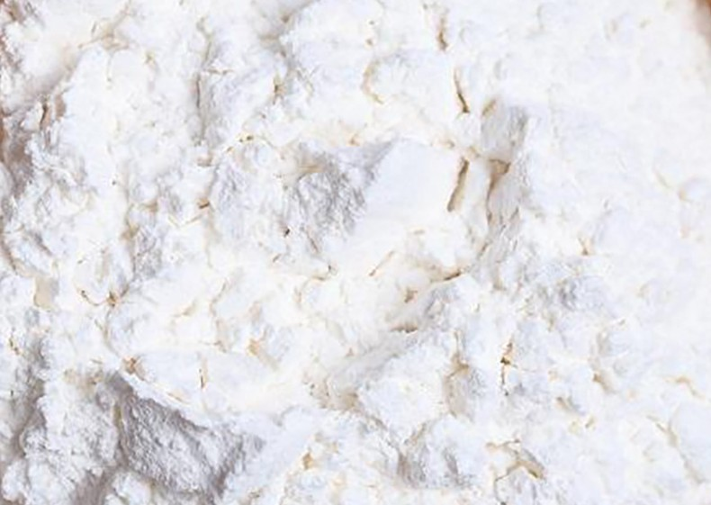
Cumin Seeds
Tablets& Capsules
Industrial Chemical
Corn Grains
Red Lentil
Flour
Coffee Beans
Lotus Seeds
08

Slide 5
10
50
1 - Very free flowing
2 - Free flowing
GRAPH 1 - Filling efficiencies
 |  |  |  |  |  |  |  |  |  |  |  |  |  |  | 3 - Slu | ggish
 |  |  |  |  |  |  |  |  |  |  |  |  |  |  | 4 - Ve | ry sluggish
 |  |  |  |  |  |  |  |  |  |  |  |  | 300 dia | 200 dia & belo | w
 |  |  |  |  |  |  |  |  |  | 600 dia | 450 500 dia | 400 dia dia
 |  |  |  |  |  |  |  |  |  | 750 dia |  | CURVES MAX RP | OF M
45
40
35
ROTOR SPEED rpm
30
25
20
15
10
5
0
75% 70%
FILLING EFFICIENCY
100%
95%
90%
85%
80%
65%
60%
55%
50%
45%
40%

Slide 6
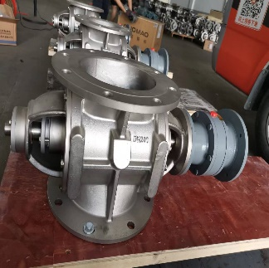
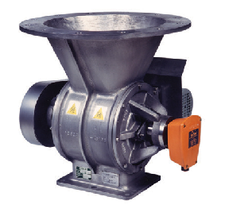
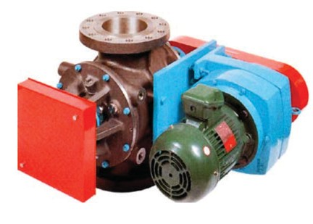
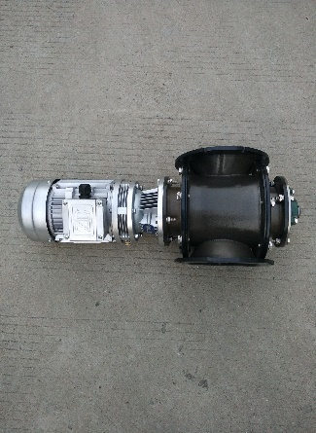
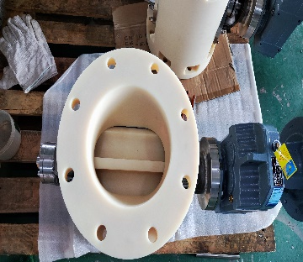
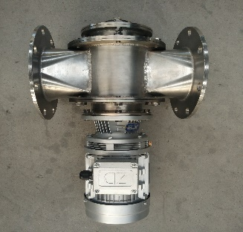
4. DETERMINING THE RIGHT CHOICE OF VALVE - CONTINUED...
temperature will increase slowly during production or may be subject to shock temperature loading i.e., sudden influx of hot product. If the latter then the Rotor, being a lighter construction, will expand quicker than the Housing, which is also subject to external surface heat loss.
4.4 Temperature Conditions
Extreme low and high operating temperatures: from Dry Ice at -80°C to continuous discharge into a pneumatic conveying line of incinerator ash at 960°C, are two examples of successful applications that have challenged all aspects of engineering content and valve design.
Clearances need to be set so that once operating temperature is reached they are at the optimum clearance for the duty. This means that leakage before the optimum has been reached will be much greater.
It is not practical to go into detailed description and options in the context of this booklet, but it is important that there is understanding as to whether the valve
Stainless Steel valve designed to act as a process separator operating under Chlorine gas an internal pressure of 7 bar pressure. Pressure Differential 100mbar.
‘Hypergienic’ Valve set as an ‘Autonomous Safety Device’ (with extended features to satisfy requirements for handling highly toxic and
sensitive pharmaceutical product.
Valve for handling light poor flowing products with extended inlet and inlet cone at precise angle required to meet product characteristics.
Tandem valve – available in two options:
1: With two sealing Rotors to minimise leakage when handling very light products that are easily windswept.
2: As a Metering Sealing assembly with upper Rotor having reduced capacity with increased
Heat resisting valve operating at 500°C continuously discharging ash and gravel from a fluid bed dryer. Incorporates auto reversing to release any product jamming.
Valve with Rotor Pocket Scraper Option. Principle of Operation: The ‘sweeping’ lower component ensures removal of sticky products
12

Slide 7
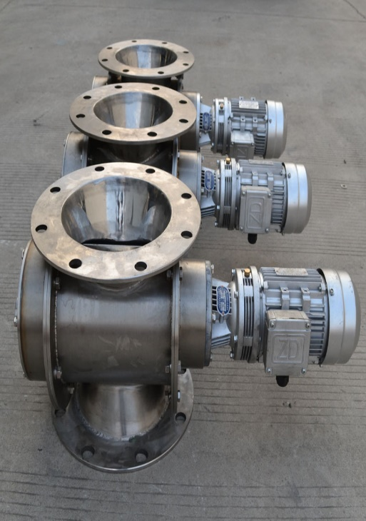
DETERMINING THE RIGHT CHOICE OF VALVE - CONTINUED...
4.5 Customer / Industry Requirements
These can be challenging aspects of supply, requiring the ability to offer flexibility in both detail valve design, manufacturing and commercial capability in order to satisfy specific customer needs and/or their individual industry standards.
4.6 Legislation Requirements
European Union Machinery Directive
A rotary valve is classed as a ‘partly completed machine’ which is intended to be incorporated into another machine or system. A certificate to this effect (declaration of incorporation) is provided for each valve.
Many users are not concerned about most aspects of valve supply providing it performs to specification, is durable and requires very basic documentation.
Other customers / Industries are more demanding to a varying degree with regard to detail design and required manufacturing practices. As well as specifying industry approved design features, there is often a requirement to be supported by extensive validation and acceptance
tests, certification, documentation, post-delivery tests etc.
Valves handling hazardous and/or toxic materials and/ or operating in controlled environments will have further extended requirements.
Model | Dimensions | power | Motor direction | Material | volume
UV-XZF-DN150 | 300*600*1000 | 0.75kw | 90°/180° | nylon /304/316L | Customize
UV-XZF-DN200 | 300*600*1000 | 0.75kw | 90°/180° | nylon /304/316L | Customize
UV-XZF-DN250 | 400*600*1000 | 1.1KW | 90°/180° | nylon /304/316L | Customize
UV-XZF-DN300 | 400*600*1000 | 1.5kw | 90°/180° | nylon /304/316L | Customize
UV-XZF-DN350 | 400*800*1200 | 2.2kw | 90°/180° | nylon /304/316L | Customize
UV-XZF-DN400 | 00*800*1500 | 3kw | 90°/180° | nylon /304/316L | Customize
13

Slide 8
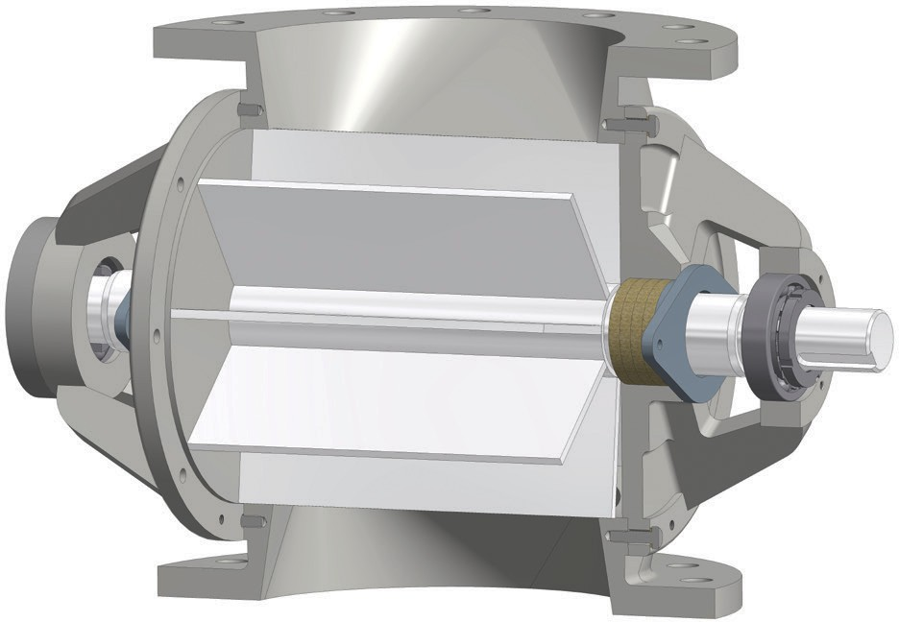
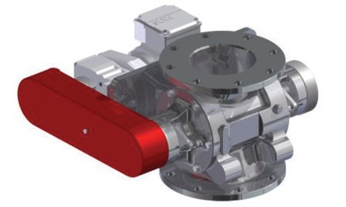
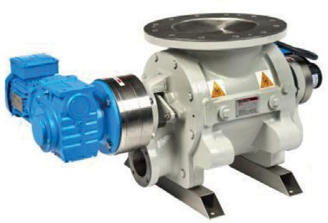
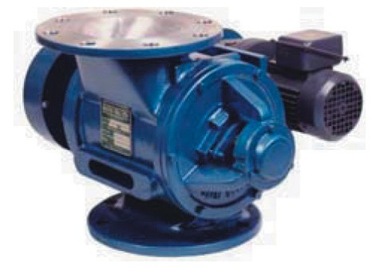
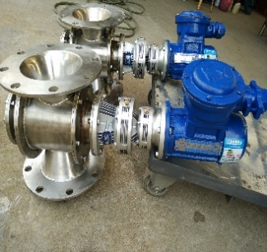
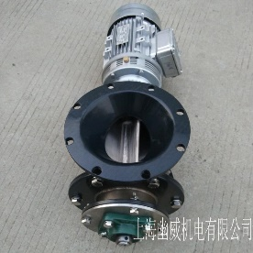
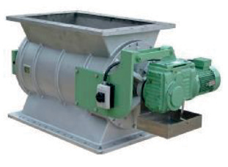
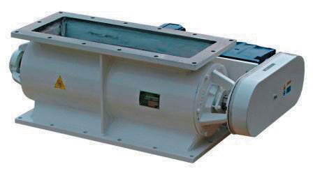
5. COMMON VALVE CONFIGURATIONS
Body: Sizes, Coatings, Ceramic Lining, Materials, Finishes, etc.
End Cover:
Materials, Coatings, Finishes, Purge Ports, Quick Release, etc.
Seals: Various Packings, Lip Seals, CIP, Air Purge, Mechanical.
Rotor:
Bearings: Various types up to 1100°C.
Primary Component- Vast range of options and configurations.
Standard Inline inlet & outlet
Blow Through – Blowing Seal For direct connection in pneumatic conveying pipelines
Offset inlet & outlet To minimise damage to granular solids
‘Fast clean’ type
For regular safe internal cleaning
‘Hypergienic’ type Dedicated for ‘High end’ Pharmaceuticals
Fabrication examples
15

Slide 9
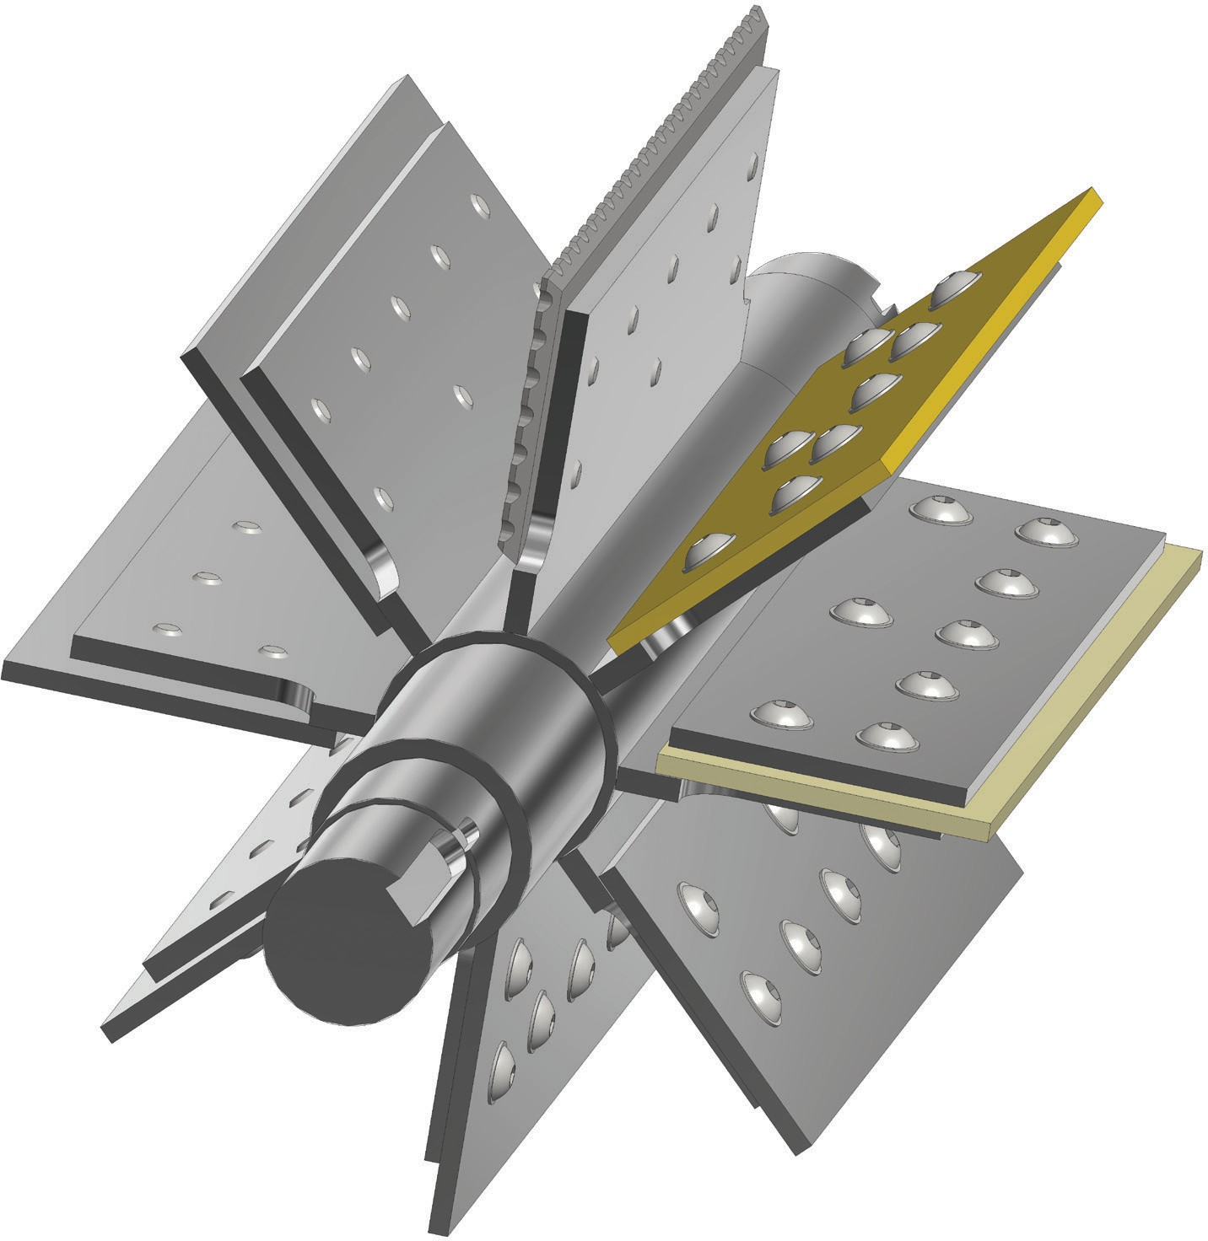
FIGURE 5. Replaceable Blade rotor sample options
Replaceable blades provide solutions for dealing with some difficult product characteristics. They also provide for in-situ adjustment to be able to run at minimum clearances and therefore leakage.
It is commonly assumed that they are included to provide adjustment to compensate for wear, however this is not the case as wear is never even.
Steel Scraper
Flexible - (variable material options) low cost option for non-friable granular products. Generally confined to low pressure differential applications.
Bronze
Scraper - for products that compress and build-up on the swept surfaces to minimise torque loads. Predominately needed for food and plastic applications requiring Stainless Steel construction.
Flexible Polymer
Phosphor Bronze - for close clearance operation for minimal leakage requirements.
Steel
Stainless Steel - for corrosion resistance and sterility.
Steel - For abrasion resistance – Hardened Steel up to around 160°C; Hard Alloy above.
Common Blade Types
16

Slide 10
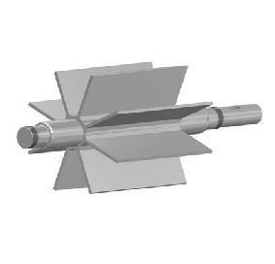
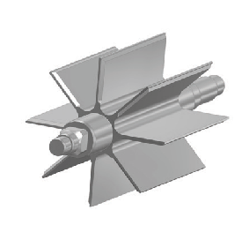
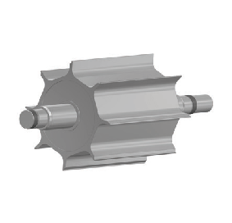
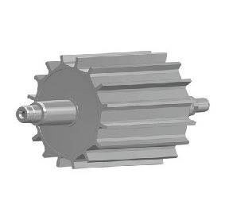
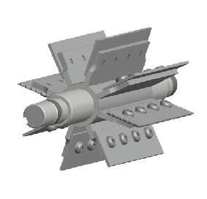
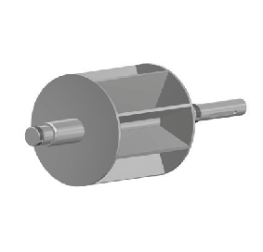
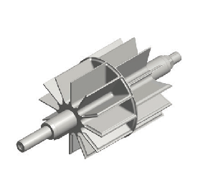
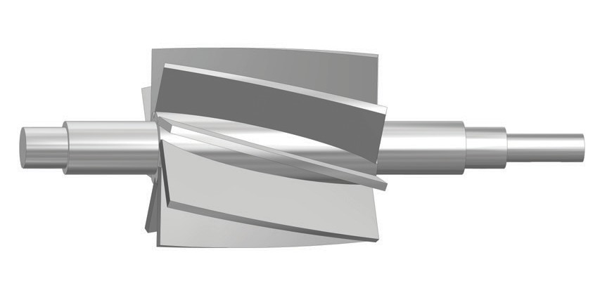
6. COMMON ROTOR DESIGNS
Open Fixed Vane
Open Fixed Chamfered
Reduced Capacity
Basic component for products that do not exhibit difficult handling characteristics.
For product that tend to smear.
For accurate control.
Reduced Capacity Multi-Vane
Replaceable Blade – .
Closed
Where product have very poor flow characteristics requiring an abnormally large inlet throat.
Staggered Pockets
Helical
For discharge into twin outlet.
Increased shear angle or reduced pulse discharge.
17

Slide 11
GRAPH 2. Effect of Clearances
(Size 200 HDM Valve)
3
0.25
2.5
STD ST. ST
0.2
LEAKAGE RATE (m³/min)
2
STD CI/MS
1.5
~ ST/NIT60
0.15
1
0.1
0.5
0.05mm
0
0
0.1
0.2
0.3 0.4 0.5
PRESSURE DIFFERENTIAL (barg)
0.6
0.7
0.8
GRAPH 3. Leakage Factors – Number of vanes (clearance 0.15mm)
(Size 200 HDM Valve)
3
2.5
LEAKAGE RATE (m³/min)
6 Vanes
2
8 Vanes
10 Vanes
1.5
12 Vanes
1
0.5
0
0
0.1
0.2
0.3 0.4 0.5
PRESSURE DIFFERENTIAL (barg)
0.6
0.7
0.8
20

Slide 12
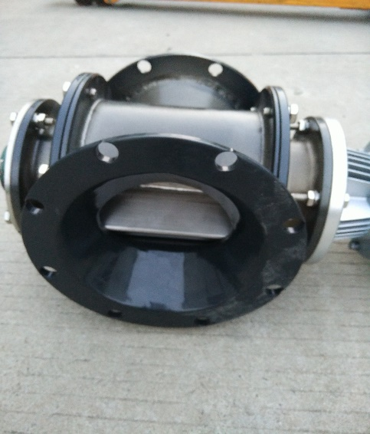
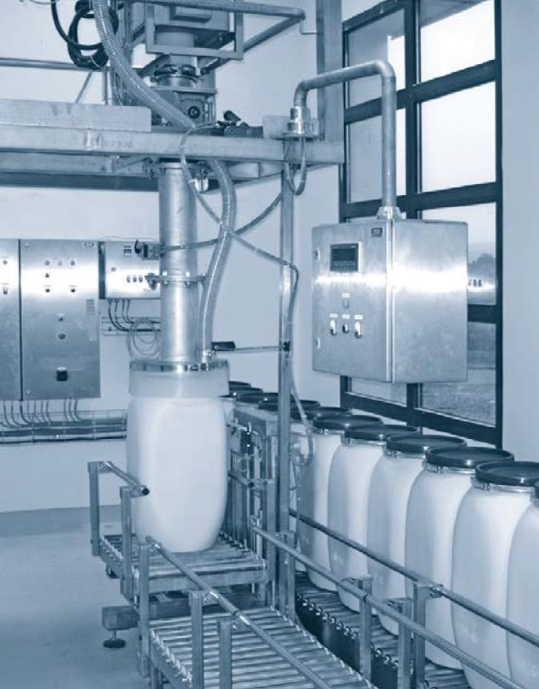
PERFORMANCE FACTORS
Valve Clearances
The escape of gas through the operating clearances is the major component of leakage consequently they need to be kept as small as practical.
Graph 2 shows leakage values at different clearances; it should be noted that changes in clearance does not produce a linear change in leakage values; another reason to keep clearances as small possible.
The graph also shows that the ‘standard’ clearance for a cast iron housing / steel rotor is set for 0.15mm and for stainless construction it is 0.2mm, the latter due to the greater risk of damaging contact should conditions give rise to it.
Graph 3 shows how leakage is reduced by fitting rotors having extra vanes. However extra vanes reduce the filling efficiency so needs to be applied with care.
Final clearances are a compromise between achieving minimal leakage yet wide enough to deal with:
Apart from the operational reasons listed above, there needs to be an allowance to provide for manufacturing tolerances.
Where there is minimal pressure differential then wider clearances can be provided to help avoid close clearance problems.
If faced with higher operating temperatures, initial clearances will need to be increased to allow for greater rotor expansion due to its lighter construction relative to the housing, such that they return to the preferred clearances when the valve has achieved a uniform temperature condition.
Where the rise is sudden e.g., the impact of hot product when first entering a valve at ambient temperature then further allowance needs to be applied.
Presence of product.
Avoiding contact between rotor and housing due to deflection from high loads caused by larger particle entrapment.
Deflection due to high operating gas pressures.
Operating temperatures.
NOTE! If valve is an Autonomous Safety Device – See page 14, then the minimum number of vanes must be 8 and the maximum clearance must not exceed 0.3mm at any time.
21

Slide 13
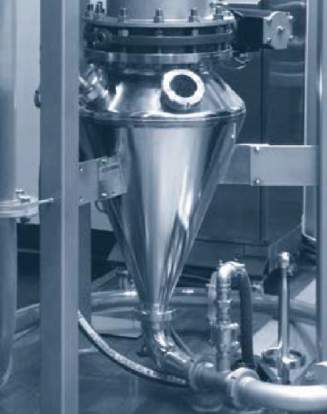
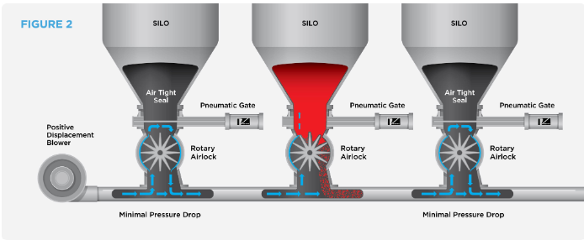
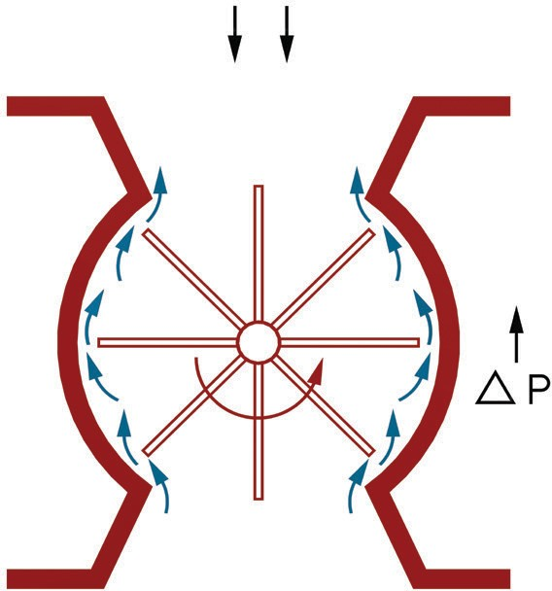
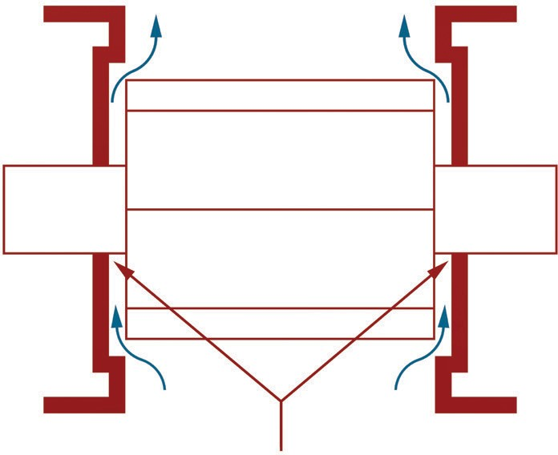
9. PERFORMANCE FACTORS - CONTINUED...
Feeding Pneumatic Conveying Systems
Feeding positive pressure pneumatic conveying systems represent around 50% of valve applications and are the most common for high pressure applications.
9.2 Leakage
Understanding leakage is an important part of the expertise in supplying rotary valves for any system.
The previous arrangements are descriptive only as much will depend on the detailed construction of the feeding hopper. Leakage is relative to conveying line loading so ensuring reliable stable product flow through the valve is critical. Cyclic and erratic overall performance is likely if there are weaknesses in the
selection of valve or design of the system as a whole.
Whenever a valve is discharging a product against a pressure differential, gas leakage will occur:
As displacement from product entering the empty rotor pockets
By transfer of higher pressure gas in the returning empty pockets
By escaping high pressure air through the operating clearances.
P₅
P₅> P₄> P₃> P₂> P₁
P₁
P₂ P₂
P₃
P₄
P₃
P₄
Constant Leakage Path
23

Slide 14
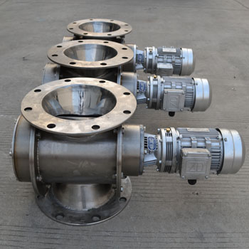
26

Slide 15
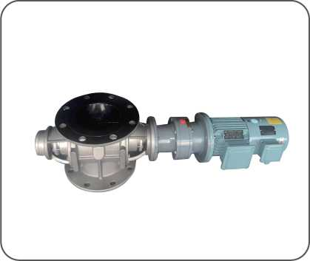
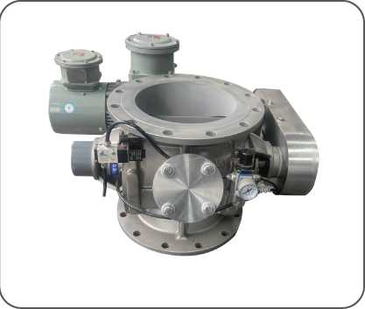
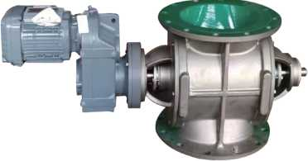
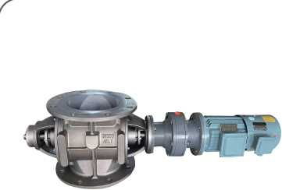
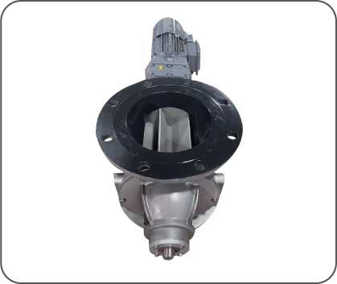
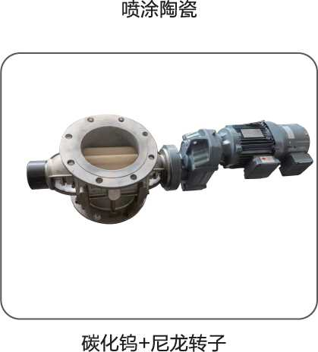
SOME MODELS

Slide 16
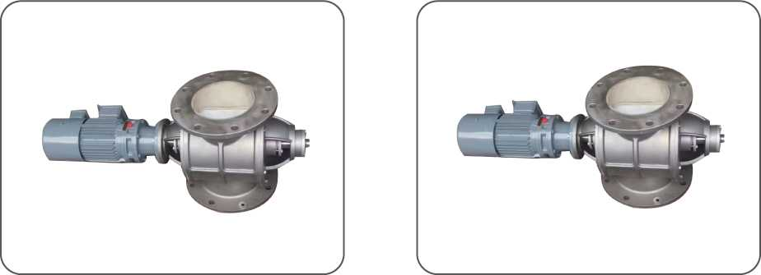
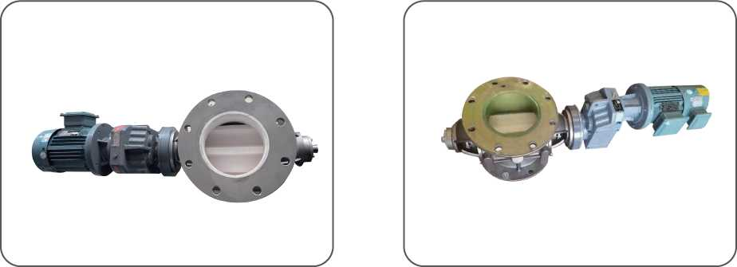
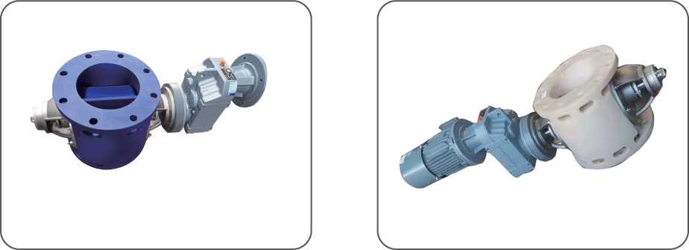

Slide 17
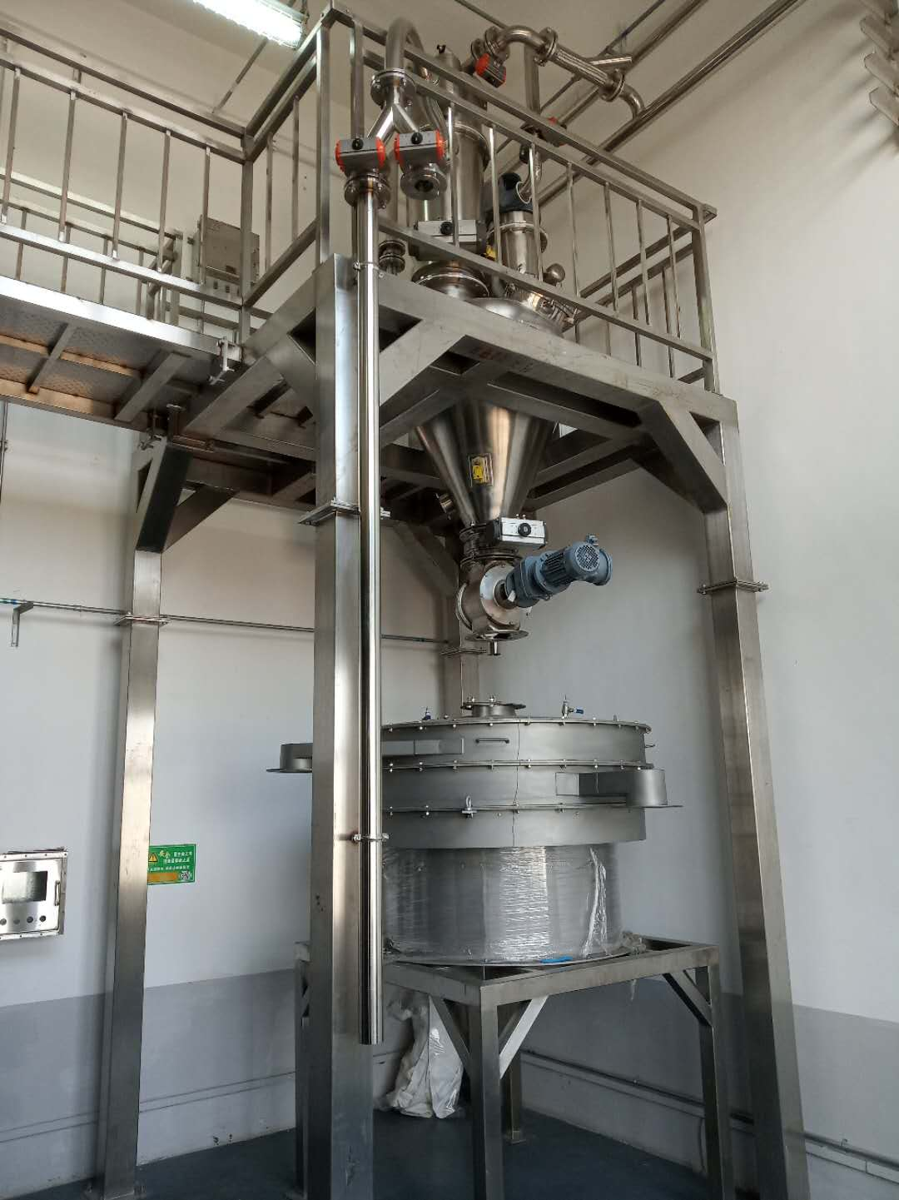
Rotary Valve in Food and Pharmaceutical
Nearly all Food and Pharmaceutical product characteristics are easily managed, and the basic design of the valve in this regard can remain relatively simple without compromising hygiene and ease of use. Common product characteristics include being sticky, cohesive, and corrosive. There is a slight tendency to build-up on the swept surfaces etc. These valves are usually made of stainless steel with polished or non-stick coated surfaces. As abrasion is not normally an issue, relieved rotor vane tips are normally incorporated as standard; this minimizes the drive torque requirements should the product tend to build up on the internal rotor surfaces. One additional feature in these valves is that they are easy to clean as apparent from their figures

Slide 18
Rotary Valve In Agricultural, Dairy, Tobacco and Grain
The Agricultural Industry makes vast use of the rotary valves in many of its fields but they are most commonly used in the Dairy and Grain Industries.
Coming to the Dairy industry first, the function of the rotary valve is to move the product while providing a strictly hygienic environment. We need to prevent bacteriological risks and rule out contamination. AL/BL type rotary valve is used for the dairy industry. Some of the special features of this design are that there are no dead corners (no angle smaller than 135°). The rotor pockets are rounded with the rotor blades beveled on three sides. All the points that come into contact with the product are polished. There are special seals that keep the flow even and can easily be inspected. This model can also easily be demounted without the help of tools. The rotary valve can be seen in the figure.

Slide 19
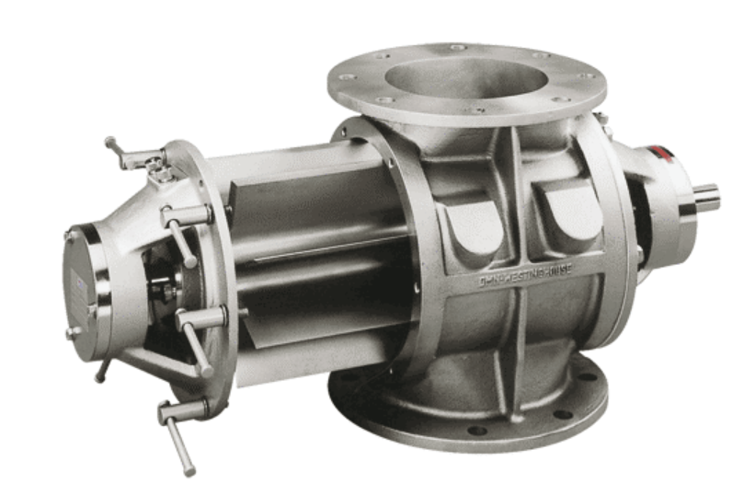
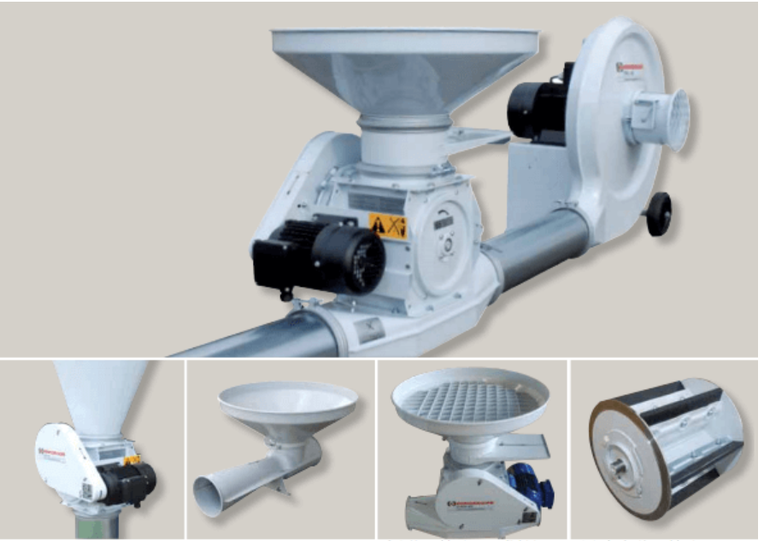
Rotary Valve In Rotary Valve in Food and Pharmaceutical

Slide 20
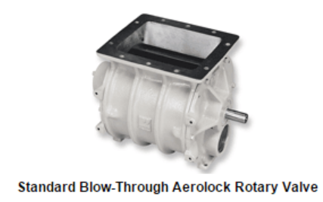
Rotary Valve in Baking and Milling Industry
Baking and Milling Industries requires feeding powdery or granular materials into a conveying system. For this purpose Blow-Through rotary valves are used as these enhance rotor clean-outs and can be installed in tight quarters.
The housing and end plates of the rotors used are machined from castings and are made of wear iron or chrome-plated wear iron. Eight blades maintain a minimum two-blade labyrinth seal to minimize air leakage. The rotors are equipped with relieved tips for materials which form skins or thin sheets on end plates and housing, or non-relieved tips for cereal products. The two types are shown below.

Slide 21
Rotary Valve in Powder Industry
In typical Powder metering applications, the rotor speed is controlled to provide a controlled flow of product into a convey line, hopper or into a vacuum pick-up vessel prior to conveying. By controlling the flow of product, we can ensure that powders can be effectively conveyed from one source to a destination at a constant rate to match the application.
The model of the rotary valve uses an eccentric structure in which the intake port and discharge port are offset, thereby reducing the volume efficiency of powders in the rotor pocket. Furthermore, special edge machining for the rotor prevents powder bite between the rotor and casing. This can be seen in the following image.

Slide 22
What We Need To Know From You
When ordering a fan shut-off fan, please provide the following items in as much detail as possible:
1. Provide the materials of the required products - carbon steel, stainless steel, aluminum alloy, titanium (TA2) special materials, etc.
2. Characteristics of conveyed materials - particle size, humidity, accumulation degree, moisture content, etc.
3. Application site - positive pressure conveying, negative pressure suction, impeller upper and lower pressure difference
4. Conveying capacity - discharge capacity per hour
5. Motor power, required speed ratio , protection provided by the motor, explosion-proof level, frequency speed regulation, etc.
(If not specified, it will be equipped with an ordinary motor)
6. Are there any special requirements for the installation dimensions (no requirement to make according to corporate standards)

Slide 23
INSTALLATION AND USE
1. The installation foot plate or frame must be kept flat and firm. If it is uneven, it must be leveled or padded, and then the bolts must be tightened;
2. When using a combination rotary valve, the motor must have overload and short-circuit protection devices to prevent the motor from burning out (see the figure below);
3. Use an adjustable wrench to rotate the impeller shaft before use in the test run. The impeller can be used only after the impeller rotates flexibly and there is no abnormal sound. Do not insert your hand into the machine to turn it to avoid hurting your fingers;
4. Please pay attention when using: when starting up, start the rotary valve first, then open the main machine to feed. When shutting down, first turn off the main machine, wait until the material in the rotary valve is emptied, and finally stop the rotary valve.
Motor overcut protection device circuit diagram: RD-fuse (2A) RJ-thermal breaker 3A (1.5KW), 2.4 (0.75KW), 2.2 (1.1KW) TA, QA one button (one red and one green) )D-motor

Slide 24
Powered by technology and survive by quality
High cost performance-super high quality, super low price
Lifetime service
Shanghai Youwei Powder Equipment Co., Ltd.
Address: No. 351, Sizhuan Highway, Songjiang District, Shanghai
Website: www.uv-powder.com
Mail:anas@uv-powder.com
Service supervision hotline: +1(213)568-6682

