Slide 1
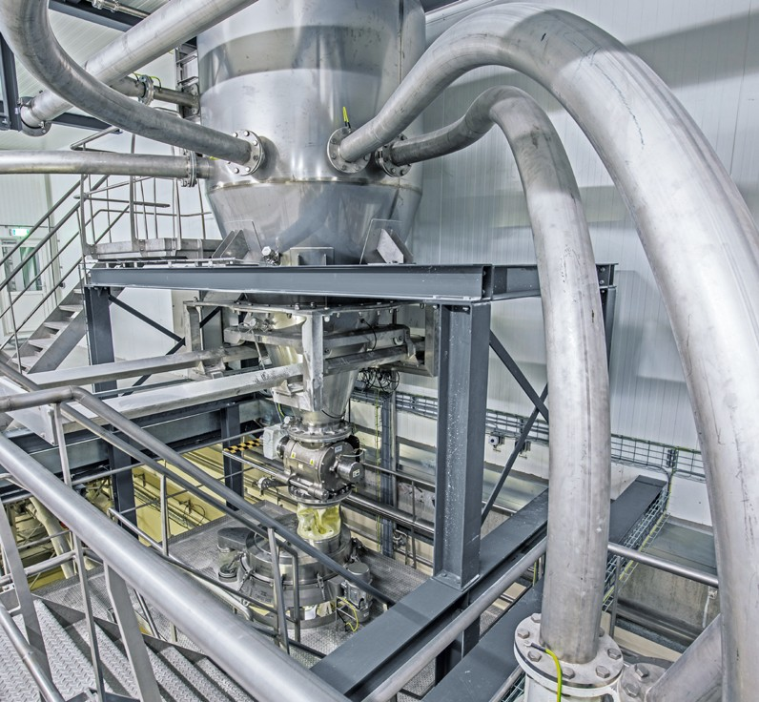
SHANGHAI YOUWEI’S
COMPETENCE IN CONVEYING
Positive pressure or vacuum, gentle or fast, short or long distances: UV has the right fit for your needs
Systems and Solutions for the
Hygienic and Safe Handling of Powders, Bulk Materials
for the Chemical, Food, Pharmaceutical and Pigment Industries
www.uv-powder.com

Slide 2
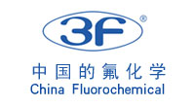
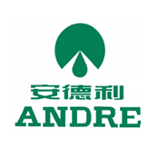
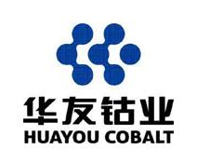
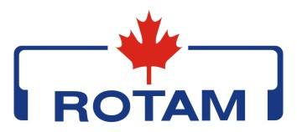
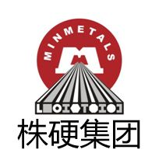
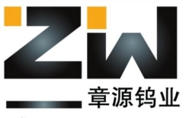
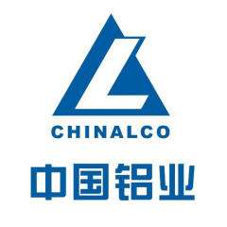
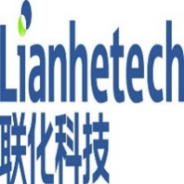
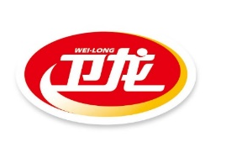
About Us
About Us
Shanghai Youwei Powder Equipment Co., Ltd. was established in 2011. It is a production-oriented processing enterprise specializing in powder unpacking, transportation, weighing, metering, batching and packaging equipment manufacturing. The company's registered capital is 12 million. The company has two processing bases in Zhangjiagang City and Qidong City, with a plant area of nearly 8,000 square meters.
With more than ten years of experience in the field of material handling automation, we have always been customer-oriented and have independently developed small bag feeding stations, ton bag unpacking machines, vacuum feeders, weighing and metering ingredients, ton bag packaging machines and other equipment. We have rich industry experience in the food ingredients industry, lithium battery anode and cathode industry, and pharmaceutical intermediates industry.
The company adheres to the spirit of integrity, pragmatism and innovation, and relies on rich technology development experience to provide high-quality systematic solutions to all types of users, and work hand in hand with users to create a better future.
Some customers

Slide 3
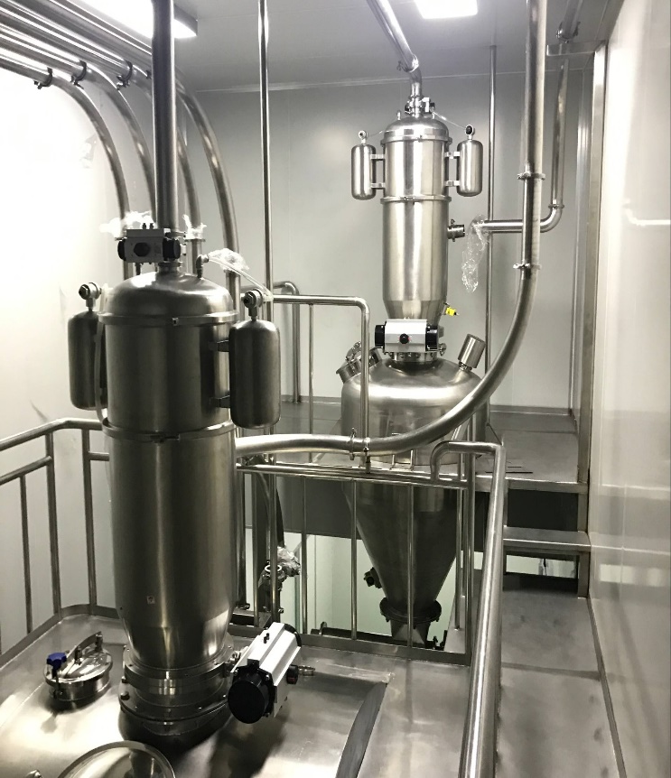
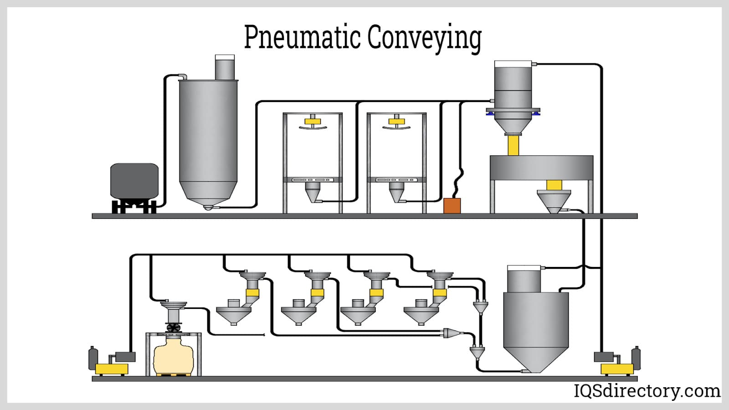
WHY CONVEYING SOLUTIONS FROM YOUWEI’S
Complete range for positive pressure and vacuum conveying
Broad experience in all key industries and many different materials
Comprehensive own range of vessels, rotary valves and automation for smooth integration
1. Dense phase positive pressure conveying:
Very gentle and efficient conveying with low gas velocities (4 – 12 m/s) with PulseFlow
Safe conveying over long distances and high capacities with moderate gas velocities (15 – 25 m/s) with DenseFlow
Safe and gentle conveying with external air injection system PulseLine
Highest operation and energy efficiency with minimal gas consumption
Conveying from one starting point to several receivers
High pressure differences
For distances up to 500 m
2. Dilute/lean phase positive pressure conveying:
Universal conveying technology with high gas velocities (20 – 40 m/s)
Low space requirements at starting point
Conveying from one starting point to several receivers
Low pressure differences
For distances up to 100 m
3. Vacuum (negative pressure) conveying:
Easy operation for short distances
Low space requirements at starting point
Conveying from several starting points to one receiver
2

Slide 4
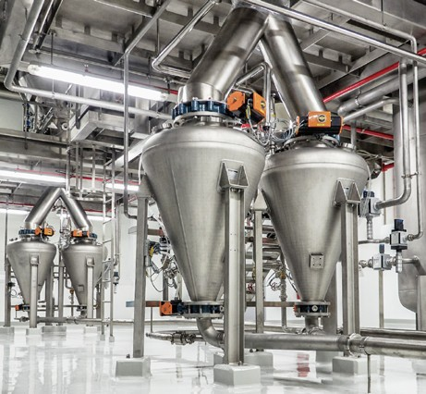
Chapter One –
What is Pneumatic Conveying?
Pneumatic conveying is a method for transferring bulk materials, like powders and granules, using compressed gas or air, from one processing center to another. Material is moved through an enclosed conveying line or tube using a combination of pressure differential and airflow from a blower or fan. The positive or negative pressure, inside the conveying line, moves materials safely with little damage or loss.
In order to function, all systems need some form of energy. For most types of machinery, energy is provided by electricity. A pneumatic system uses compressed air to create energy using air from a storage unit and depends on the pressure created when the air is pulled into an enclosed space.
The principle of a pneumatic system is built on the concept that bulk materials such as grains, cement, powders, and chips can be moved through a pipeline using air as the power and vehicle. The enclosed pressurized air creates a propulsion force, which moves bulk materials.
Pneumatic conveying systems transport cement, fly ash, starch, sugar, salt, sand, plastic pellets, oats, polymers, lime, soda ash, plastic resin, plastic powder, dry milk, and feeds in a cost and energy efficient way from railcars, trucks, or silos. Other uses of pneumatic conveying include intermodal or transloading, in plant transfer, and dust control.
Use our expertise!
With the experience from more than 10’000 installed pneumatic conveying systems, YOUWEI can offer the technology most suitable for your application.
3

Slide 5
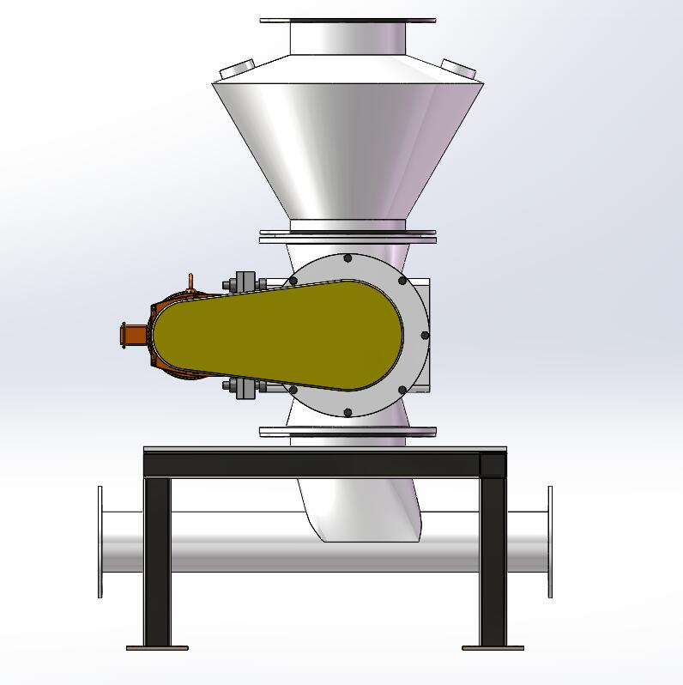
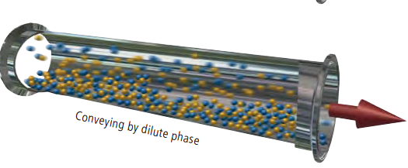
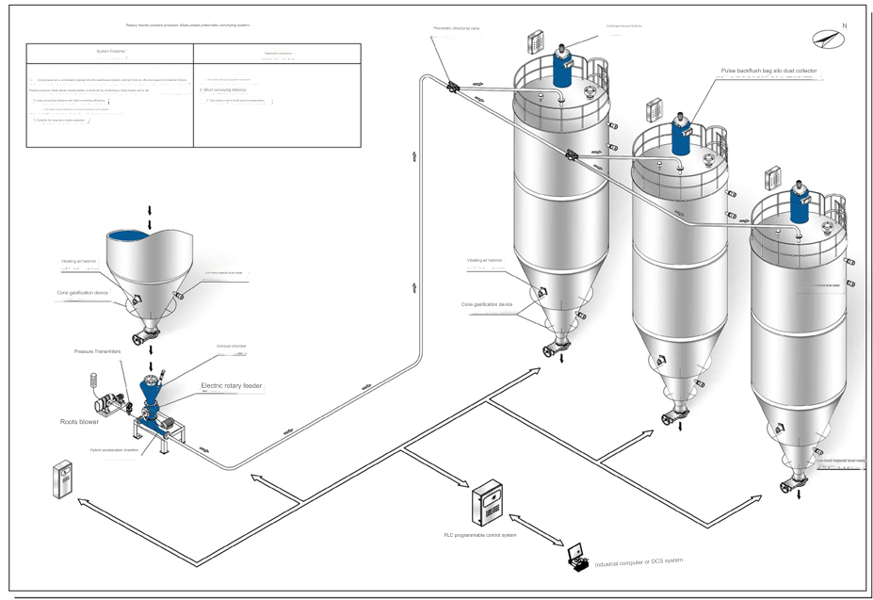
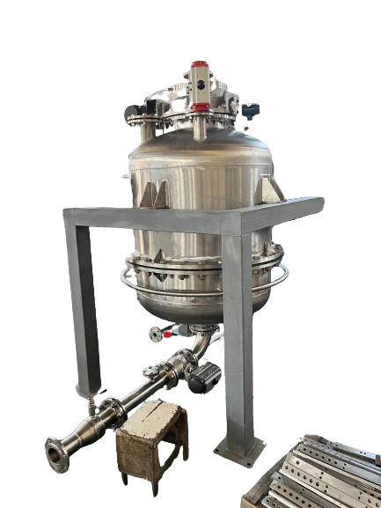
Chapter Two –
Types of Pneumatic Conveying
Pneumatic Conveying Types
The forms of pneumatic conveying are the dilute phase and dense phase. Each type moves materials using air pressure and an enclosed line or tube. The difference between them is their method of creating air pressure and how the material travels through the system.
Positive pressure dilute phase pneumatic conveying generally uses Roots blowers as the power source, and the conveying distance can be as long as 100-300 meters. It can realize multi-point feeding and multi-point discharging. The conveying equipment consists of fans, air rotary valves, accelerators, silos, and dust collectors. The air rotary valve completes the functions of uniform feeding and air locking, and transports the material to the low-pressure accelerated conveying system; the powder conveying pump uses a uniquely designed nozzle to evenly mix the powdery material and the conveying airflow, and transport the powdery material to into the conveying pipe; using the strong airflow provided by the fan and the pressure difference in the pipe, the material is sent to the destination along the pipe; the entire conveying process is completed.
Dilute Phase
Equipment schematic diagram:

Slide 6
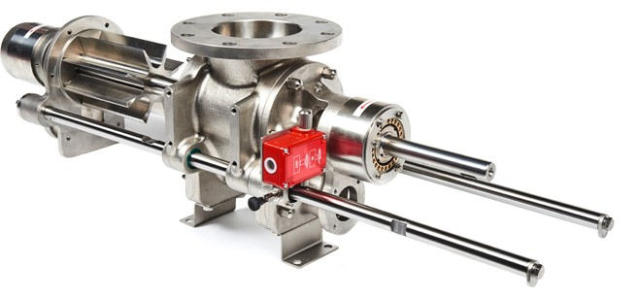
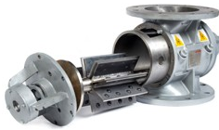
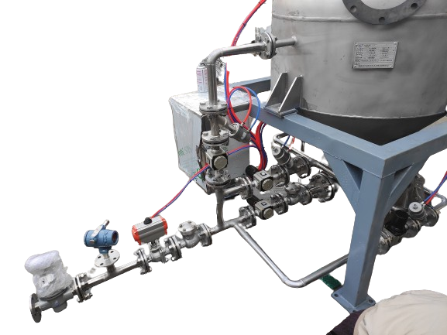
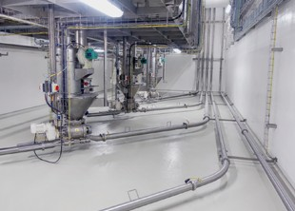
DILUTE PHASE CONVEYING
DILUTE PHASE CONVEYING
Easy to implement and versatile, lean or dilute phase conveying can be the perfect solution for many nonsensitive powders and bulk materials.
Why dilute phase solutions from YOUWEI?
Broad experience from many applications
Complete own range of rotary valves
Easy to clean valves for hygienic applications or product changeover
Lean or dilute phase conveying systems are the ideal solution for transferring bulk materials that do not require particle preservation and are not abrasive. Its advantage lies in the versatility of products that can be conveyed as well as in the space saving setup.
The product is usually introduced by means of a rotary valve into the piping system. A sufficiently high gas velocity (typically >20 m/s) is required to keep the particles in suspension (keep the particles „flying“) and to convey the bulk solids into the receiving hopper. YOUWEI’S rotary valves and the configuration of the product intake minimises the damage of the equipment by the unavoidable leakage air.
Your benefits
YOUWEI’S lean phase conveying systems are economical and reliable solutions
Simple setup of the system
Little headroom necessary for installation
The throughput can be varied by controlling the rotational speed of the rotary valve
Lean phase conveying systems can be used with in-line sifters for screening applications
YOUWEI’S RotaVal rotary valves are available as easy to clean extractable units, with re-enforced replaceable blade inserts or in special executions for pharma and nutrition

Slide 7
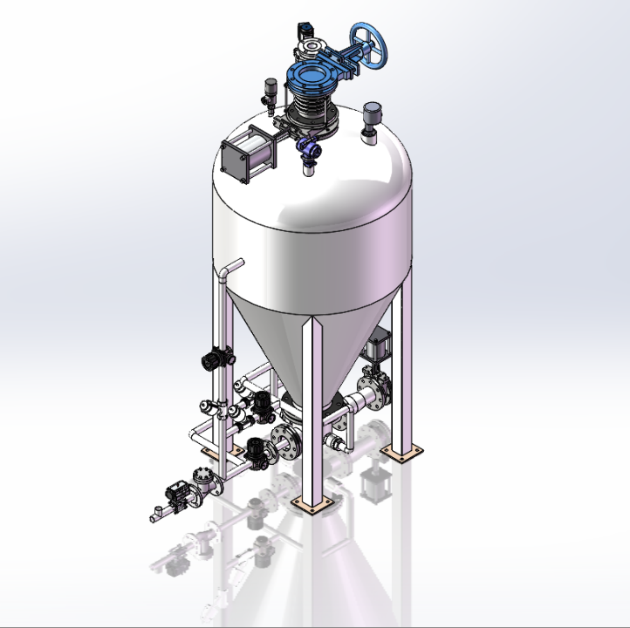
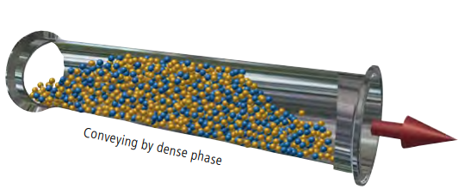
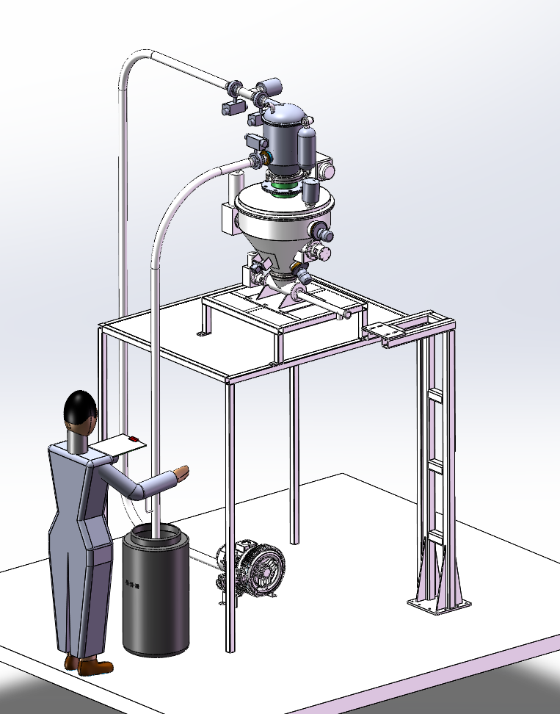
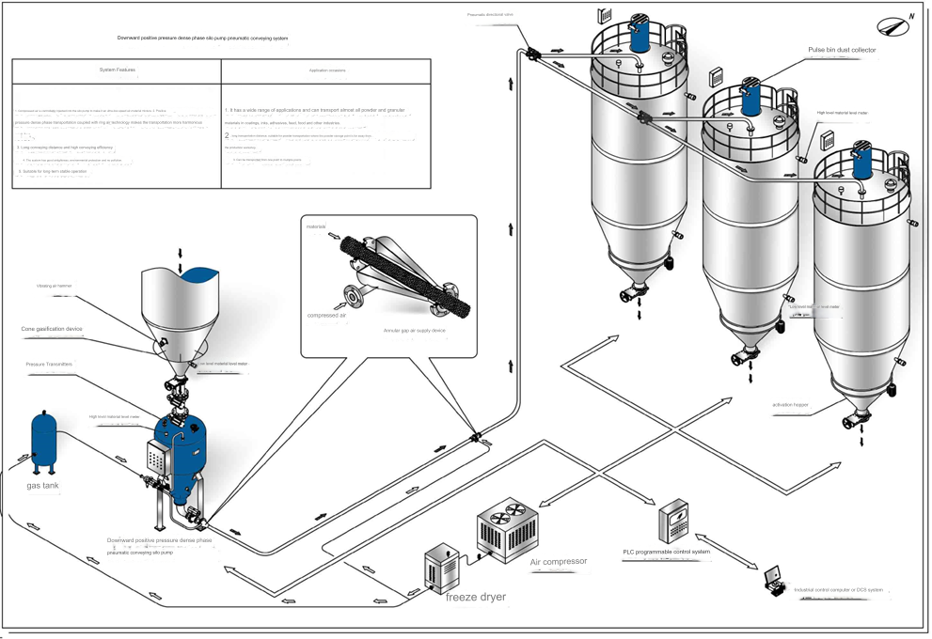
Chapter Two –
Types of Pneumatic Conveying
Dense Phase
Dense Phase Pneumatic Conveying uses a small amount of air to move a large amount of material in slugs, much like extruding. A dense phase system pushes a denser concentration of bulk solids at low velocities, as can be seen in the diagram below.
The positive pressure dense phase pneumatic conveying device uses the form of a sending tank to send materials, and the air source pressure with a pressure greater than 1kg/cm2 pushes the materials through the conveying pipeline. The main features are large transportation volume, long transportation distance, high gas-to-solid ratio, low gas flow rate, and small pipeline wear. The conveyor pump equipment, also known as air flow conveying, uses the energy of air flow to convey horizontally, vertically or obliquely.
Equipment schematic diagram:

Slide 8
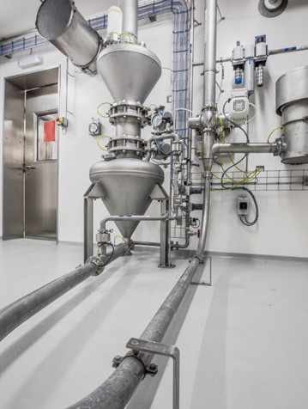
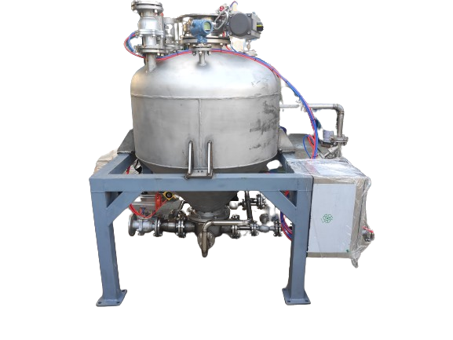
DENSE PHASE CONVEYING
Why dense phase solutions from YOUWEI?
Broad experience in gentle conveying of fragile products
Air and energy saving designs with sophisticated air control
Secure, proven and reliable
Dense phase pneumatic conveying systems are used when the product quality is of the highest importance. They minimise changes in bulk density and particle size distribution and also limit segregation effects.
Pressure vessels are utilised within dense phase conveying systems to introduce the bulk solids into the pipeline. Contrary to using rotary valves, the system has no leakage and is absolutely gas tight.
This allows a high pressure range from 1 barg up to 6 barg, or more. The high loading and low velocity lead to gentle conveying and to low wear of both pipeline and receiver.
With dense phase conveying systems, the transport of bulk solids is possible from short distances right up to long distances of several hundred meters.
Your benefits
Very gentle handling of fragile products
Minimised wear of pipeline and bends
Minimised seggregation of mixed products
Absence of rotating parts eliminate the danger of metal contamination and reduce maintenance costs
Gas and dust tight system with no leakage air
Batch weighing of pressure vessel possible
High solids loading leads to smaller pipe diameter
Low gas consumption reduces the required filter area on receiver leading to low operation and energy costs
Different executions available suited for all types of industries
Ready to use graphical pneumatic conveying controller STP 61

Slide 9
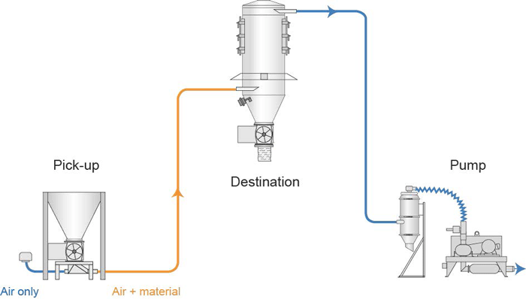
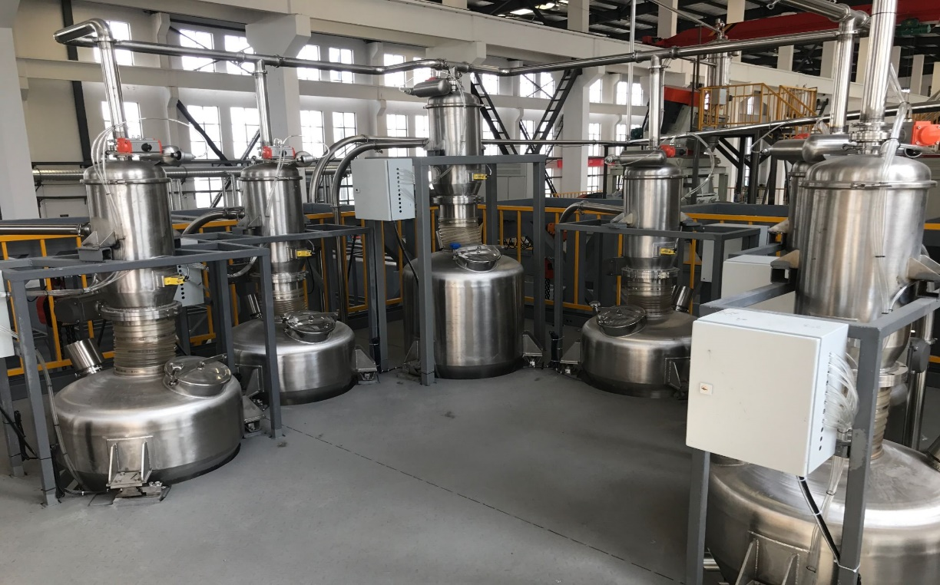
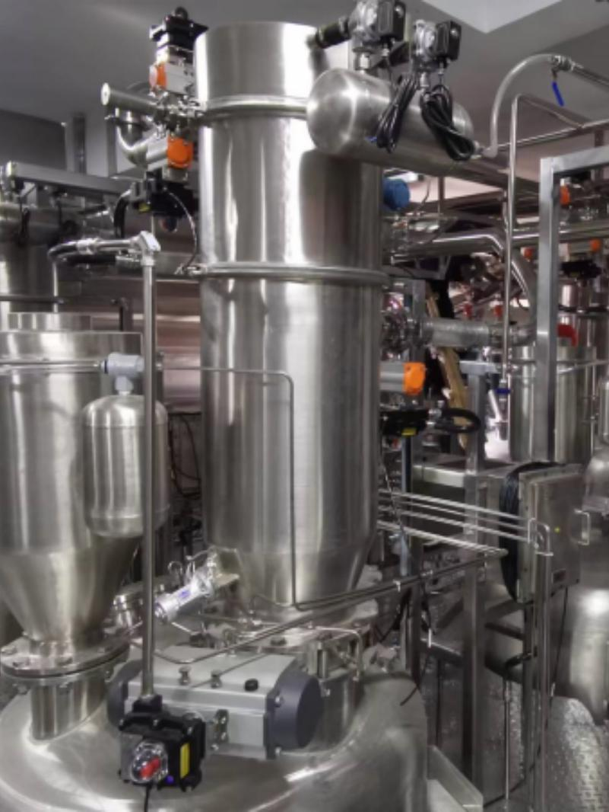
VACUUM CONVEYING
The compact and cost friendly approach to many conveying needs.
YOUWEI offers a versatile range of vacuum conveying solutions powered by venturi ejectors or electric vacuum pumps. The modular design allows adaptation to various processes such as sack tipping, drum unloading, BBU Big Bag Unloading, feeder refilling, and reactor loading. These compact and lightweight vacuum conveyors are suitable for both manual and automated operations.
Your benefits
Dust free conveying. Potential leaks are contained within the system.
When operated with a vacuum ejector, simply connect the system to the existing compressed air net and run the system.
Suitable for use in explosive atmospheres
Hygienic and enclosed design and construction details available
Additional equipment can be positioned directly into the conveying line (inline sifter, nibblers, cone mills etc...).
Compact and light weight receiving vessels
Modular construction for ease of strip down shortens cleaning time and maintenance interruption
Control units units can be pneumatically operated without ignition sources.

Slide 10
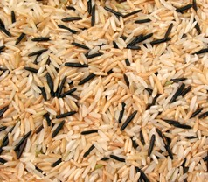
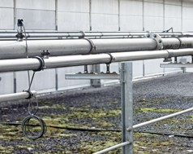
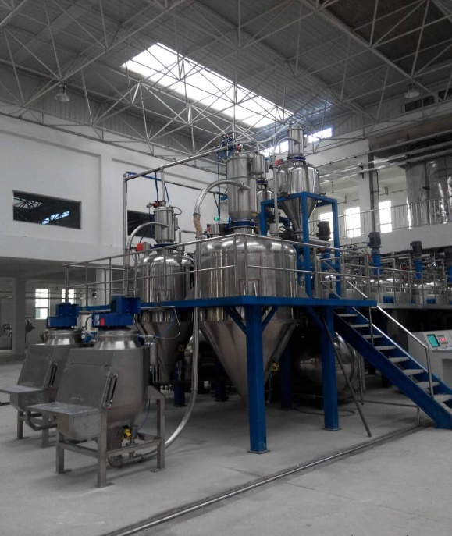
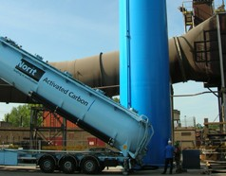
THE RIGHT SOLUTION
FOR ALL CONVEYING NEEDS !
 | Fragile goods Dense phase conveying is in many cases a perfect solution for the transport of fragile goods. Trials in our test centres help establish the best configuration, even for the most sensitive products.
Long distances Positive pressure conveying can create a higher pressure difference than vacuum conveying and allows for many materials conveying distances exceeding 200 m and more.
High capacities Many applications especially in heavy industries ask for high transport capacities. Even systems beyond 100t/h have been realised and prove their reliability every day under the most demanding conditions.
Truck unloading Pneumatic conveying can be used for dust-free and safe unloading of trucks with direct transport to a storage silo.
4

Slide 11
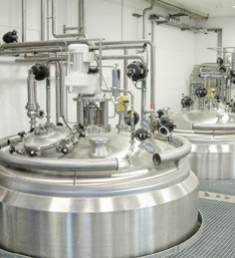
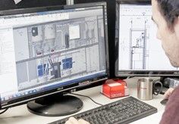
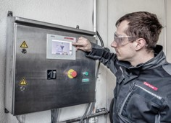
THE RIGHT SOLUTION
FOR ALL CONVEYING NEEDS !
Reactor filling Direct conveying into a reactor is a safe and emission-free way to bring the product directly to the process. Conveying is even possible against overpressure, above or below liquid level.
Global Service and Support – We speak your language With our global network of subsidiaries, test centres and partners, we support our customers in all parts of the world. Wherever you are, we will be with you.
Bespoke solutions To satisfy even the most complex powder handling requirements, YOUWEI can custom create complete lines including product reception, storage, recipe preparation, mixing and conditioning.
Industry 4.0 is here – Assess, Prevent, Predict YOUWEI has extensive experience, not only in powder processing, but also in automation and sensor integration. Our systems can allow for on-line access to sensors, analytics and direct diagnostics, to assess the process and the machines, or for maintenance planning.
5

Slide 12
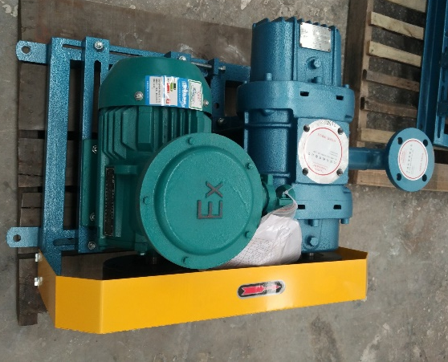
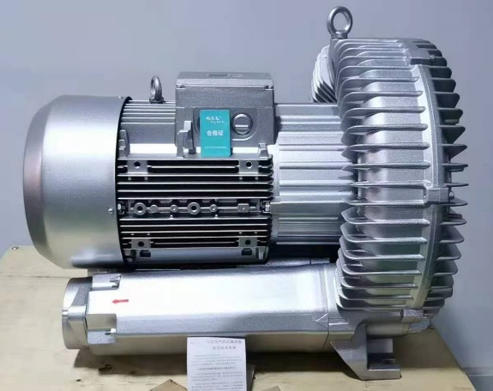
Chapter Three – Pneumatic Conveying Design
All pneumatic systems use pipes or ducts to transport materials on a stream of air. An air mover generates pressure or a vacuum and is located in the system at the beginning to push materials through the line or at the end to pull materials through.
The basic components of a pneumatic system are:
Pressure blower or vacuum pump
Rotary airlock valves
Conveying line
Diverter valves
Filter receiver
Cyclone separators
Batching systems
Hoppers
Controls
Vacuum Blower
A pressure blower is a pneumatic conveying method used to move materials. When designing a system, pressure drop is crucial, especially at the system's end. The blower's force determines flow rate (CFM), velocity, and pressure, pushing material through the pipeline.
YOUWEI offers a diverse range of vacuum blowers tailored to meet the specific needs of each customer, ensuring optimal suitability for various applications.
Water circulating
vacuum pump
Roots blower
vacuum pump
High pressure fan

Slide 13
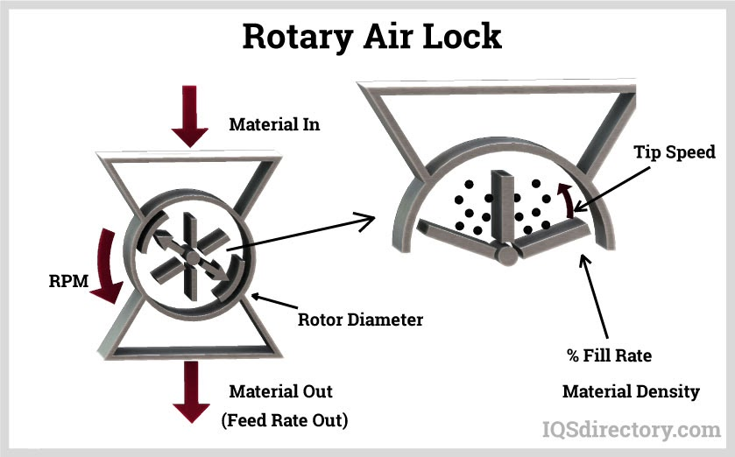
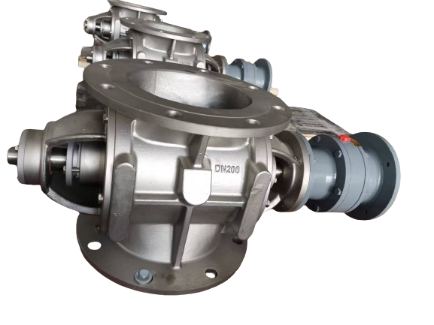
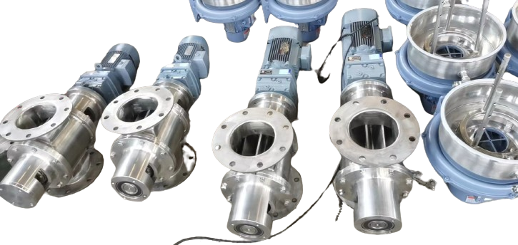
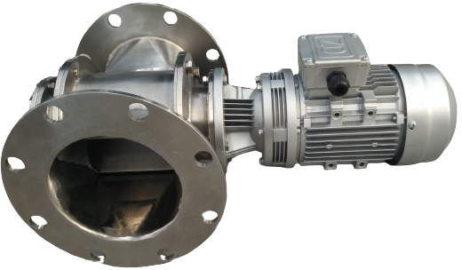
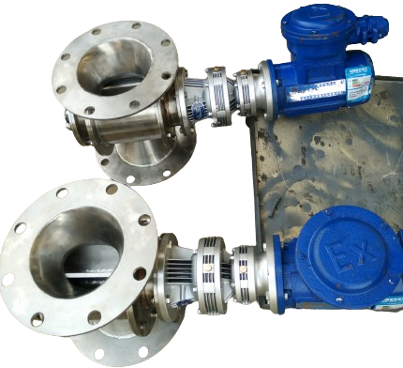
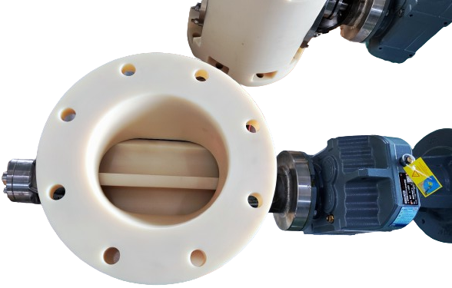
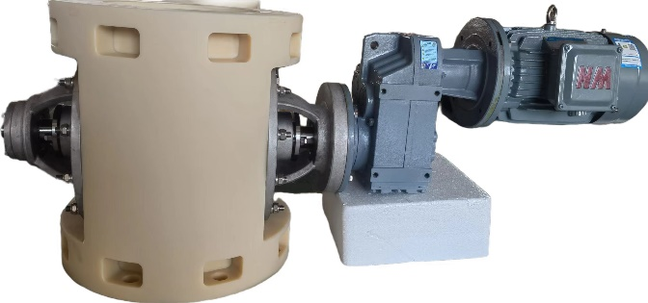
Chapter Three – Pneumatic Conveying Design
Rotary Airlock Valves
Rotary airlock valves are used for handling solids when it is necessary to separate two areas under pressure, while moving the material from one condition to the next. They are used at the beginning and end of a pneumatic conveying system.
UV provides an extensive range of rotary airlock valves meticulously designed to meet the unique requirements of our valued customers.

Slide 14
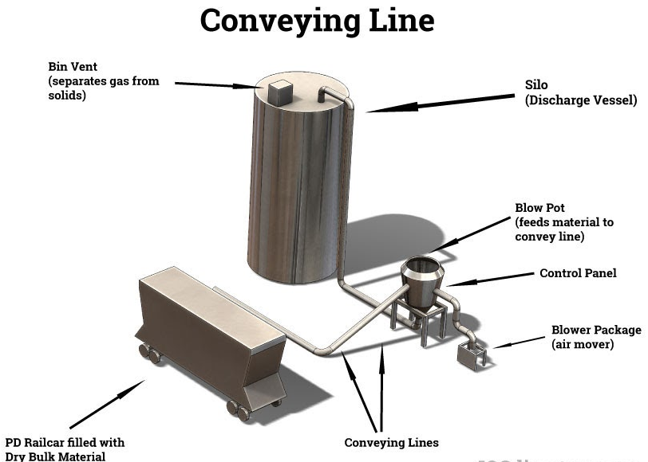
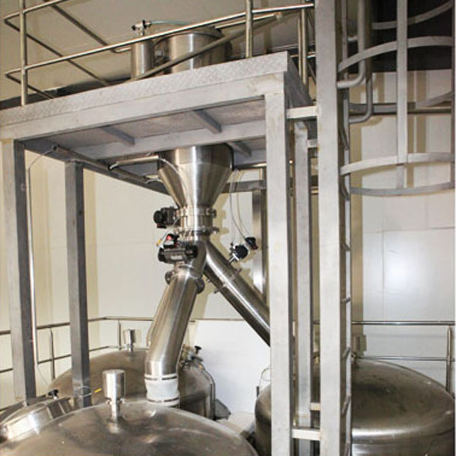
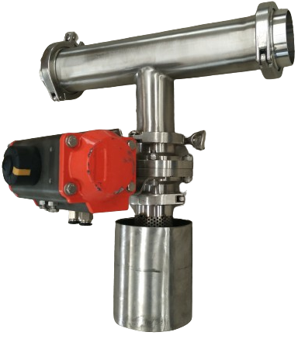
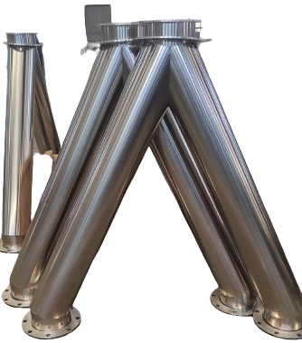
Chapter Three – Pneumatic Conveying Design
Conveying Line
Conveying line contains the material and method of transport, as can be seen in the diagram below. UV specializes in providing robust and reliable conveying lines, meticulously engineered to excel in material handling applications.
Diverter Valve The diverter valve, as depicted in the diagram, prevents contamination and facilitates line switching. Crafted from cast iron, aluminum, or stainless steel, it reroutes product between conveying lines. The valve, sealed with polyurethane rubber, features a gap-free parabolic shape. UV offers a diverse range of valves designed to ensure smooth and efficient material handling for our valued customers.

Slide 15
Chapter Three – Pneumatic Conveying Design
Filter Receivers
Filter receivers contain and separate dust from material in a pneumatic conveying system. The unwanted airborne material is trapped in the filter in the receiver unit as seen in the diagram on the right
UV delivers high-quality Filter Receivers designed to meet the exacting standards of our valued customers.
Cyclone Separator
Cyclone separator uses centrifugal force to remove particles from air in a pneumatic conveying system. Air enters the cyclone whose rapid rotation separates the particles, which are blown against the wall and fall to the bottom of the container.
UV presents a comprehensive selection of separators to enhance material management for our esteemed clientele.

Slide 16
Chapter Three – Pneumatic Conveying Design
Batching System
UV excels in pneumatic conveying with advanced batching systems, seamlessly integrating ingredient mixing. Our systems enhance efficiency, ensuring smooth and effective operations while accommodating increased pneumatic system capacities.
Hopper Our company offers high-quality and efficient hoppers designed to contain materials before introducing them into the conveying line. Equipped with a rotary airlock valve, our hoppers ensure precise material release, as depicted in the accompanying diagram.

Slide 17
Chapter Three – Pneumatic Conveying Design
Controller YOUWEI delivers a comprehensive range of controllers essential for pneumatic conveying systems. Tailored to meet specific system configurations, our controllers utilize microprocessors or PLC-based technology. They efficiently manage blower and filter operations, valve control, receiving hopper functions, loader operations, and PC-controlled filter pulsing.

Slide 18
Invest in your operators' well-being and boost your production efficiency with SHANGHAI YOUWEI Contact us today to learn more!
Powered by technology and survive by quality
High cost performance-super high quality, super low price
Lifetime service
Shanghai Youwei Powder Equipment Co., Ltd.
Address: No. 351, Sizhuan Highway, Songjiang District, Shanghai
Website: www.uv-powder.com
Mail:anas@uv-powder.com
Service supervision hotline: +1(213)569-6682

